Slide 1



Design & Build Group 9

Slide 2
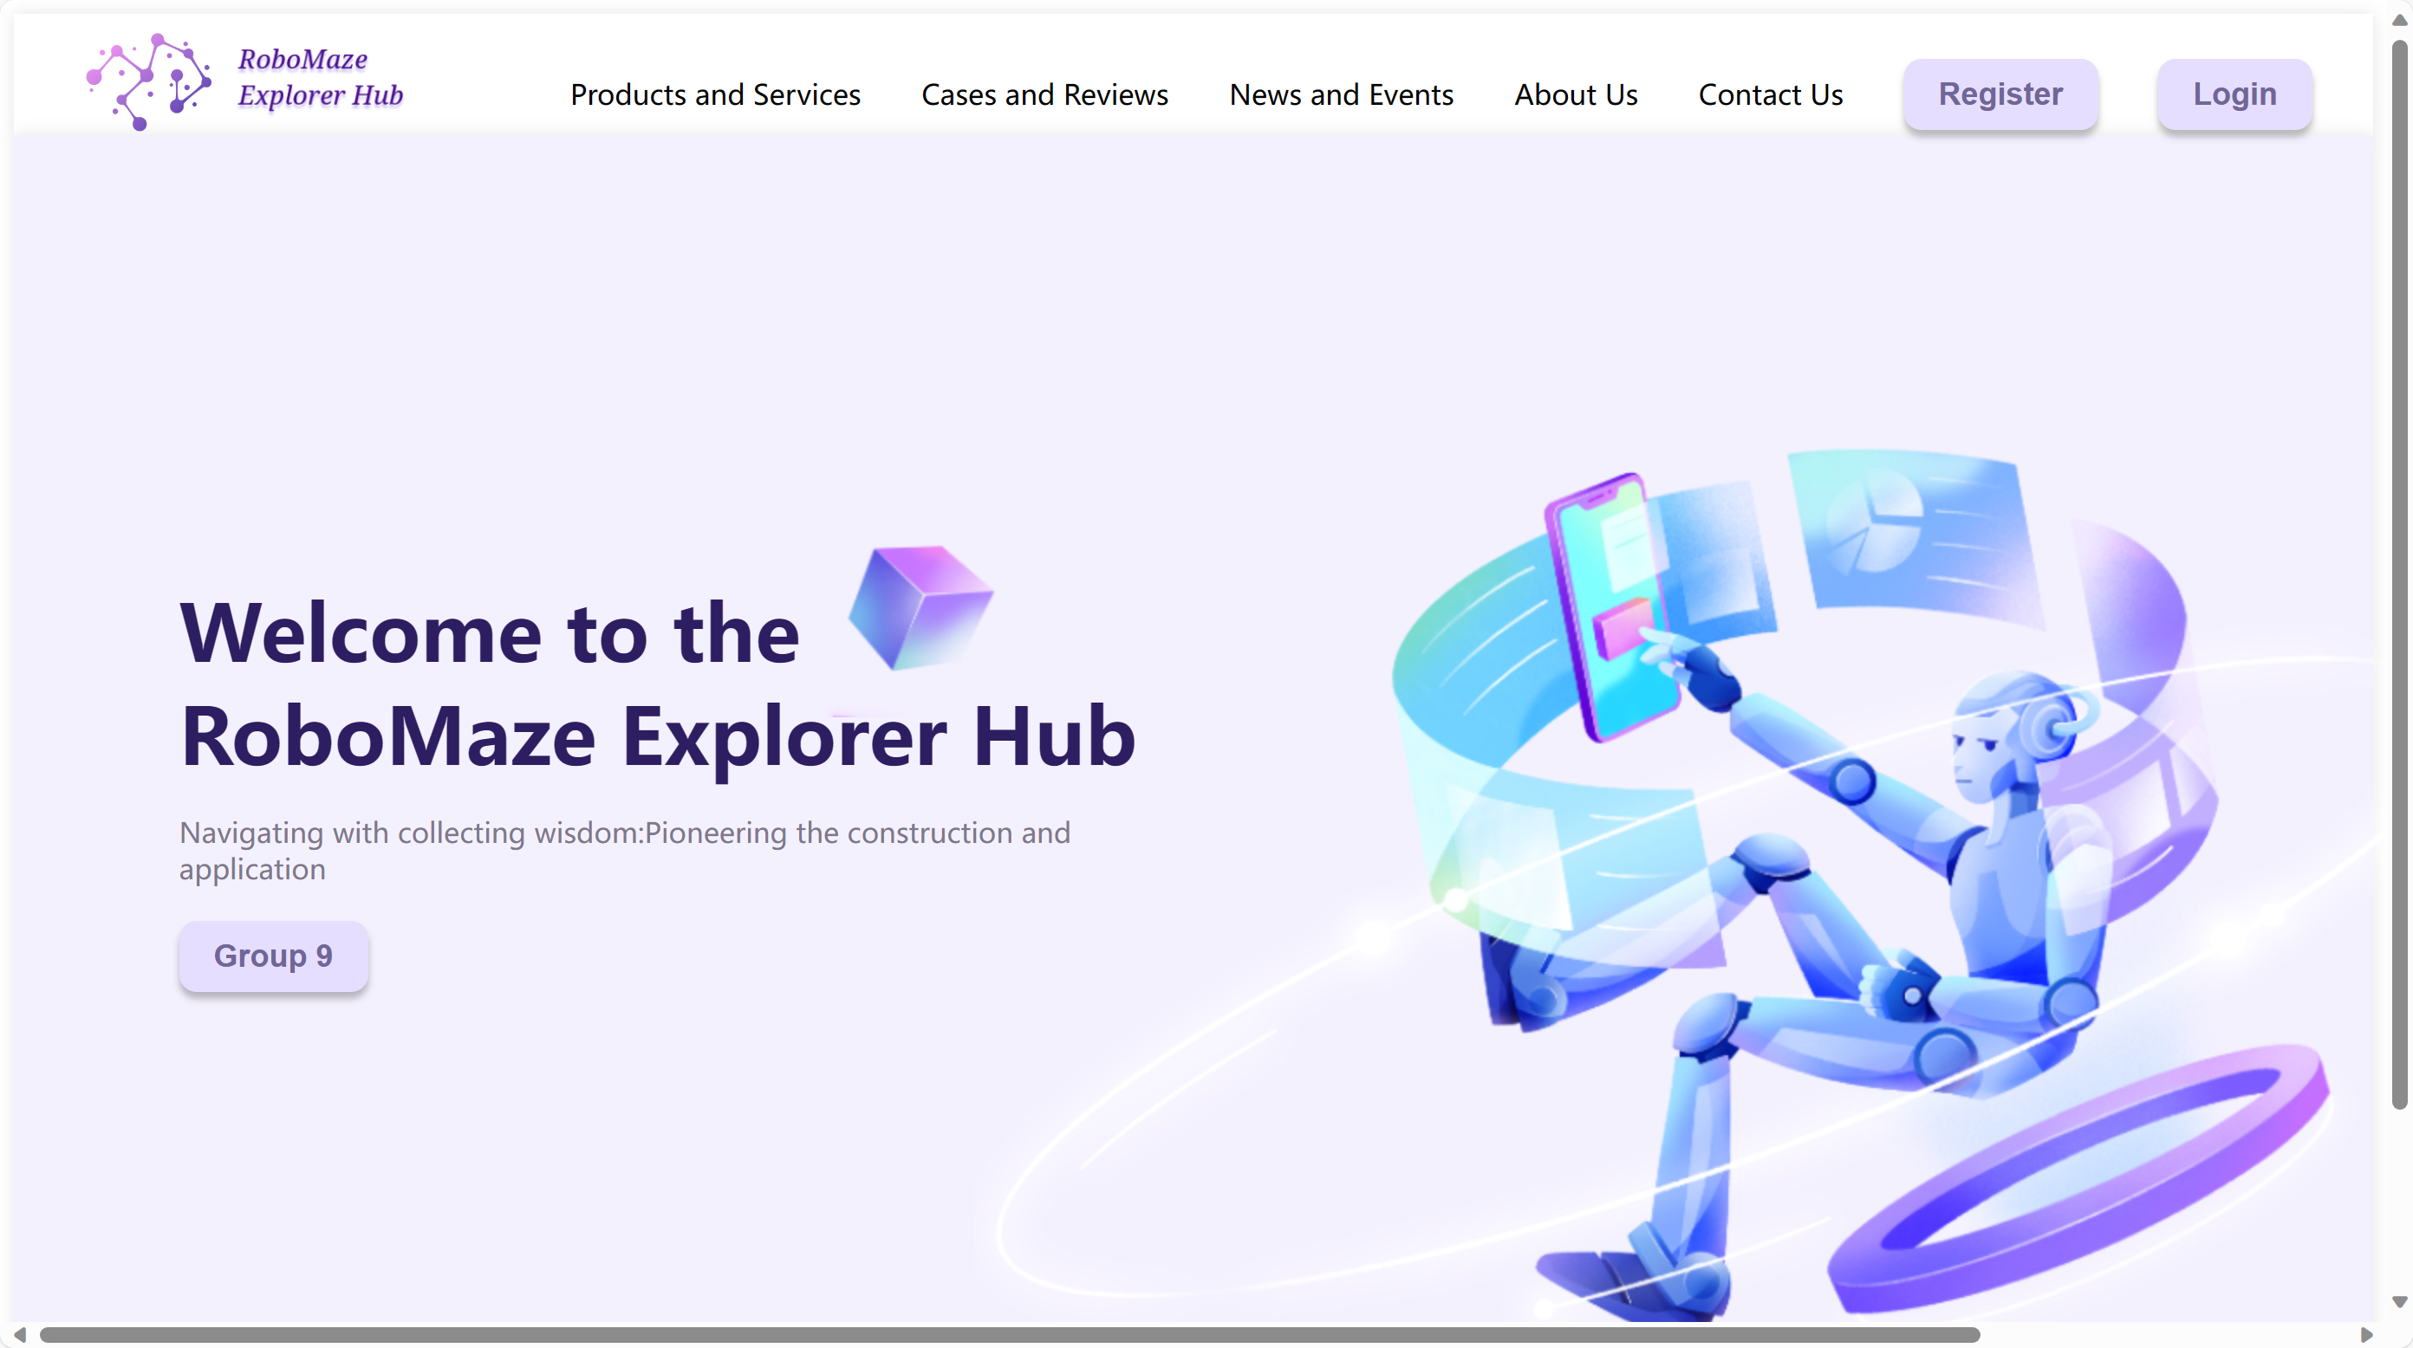
1. Home page (website)

Slide 3
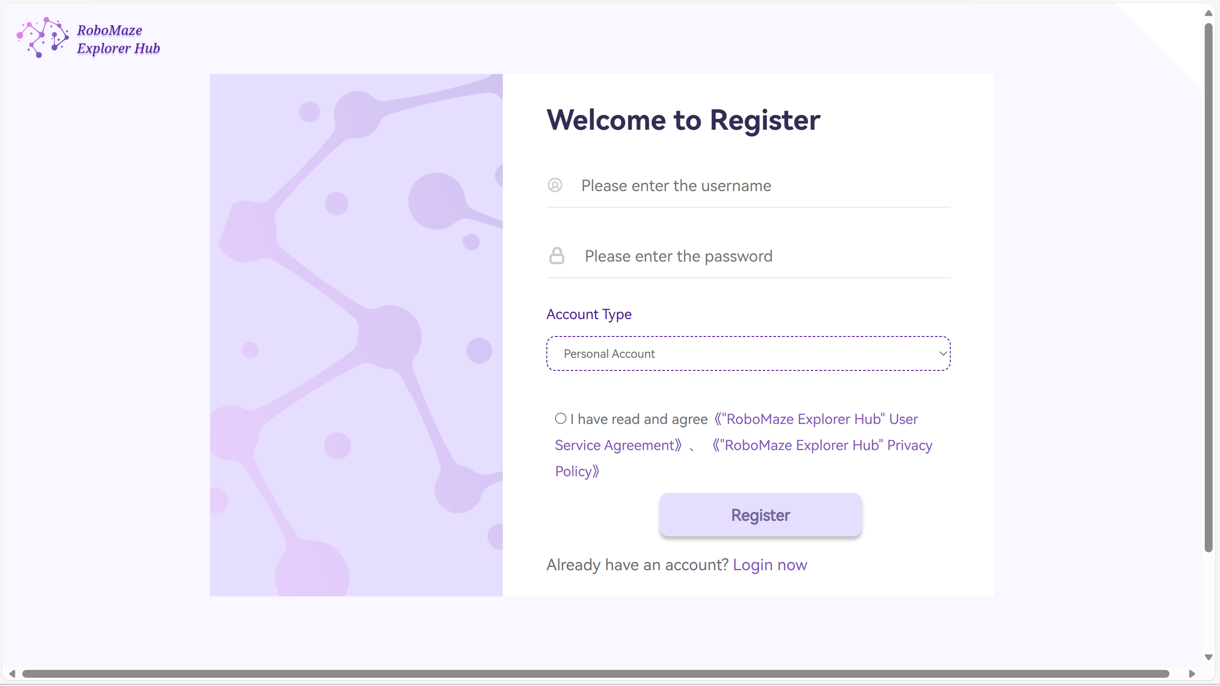
enrollment
Creating an account;
Choosing the type of account;
Checking privacy policy and service agreement;
Returning to the login page automatically after enrollment.

Slide 4
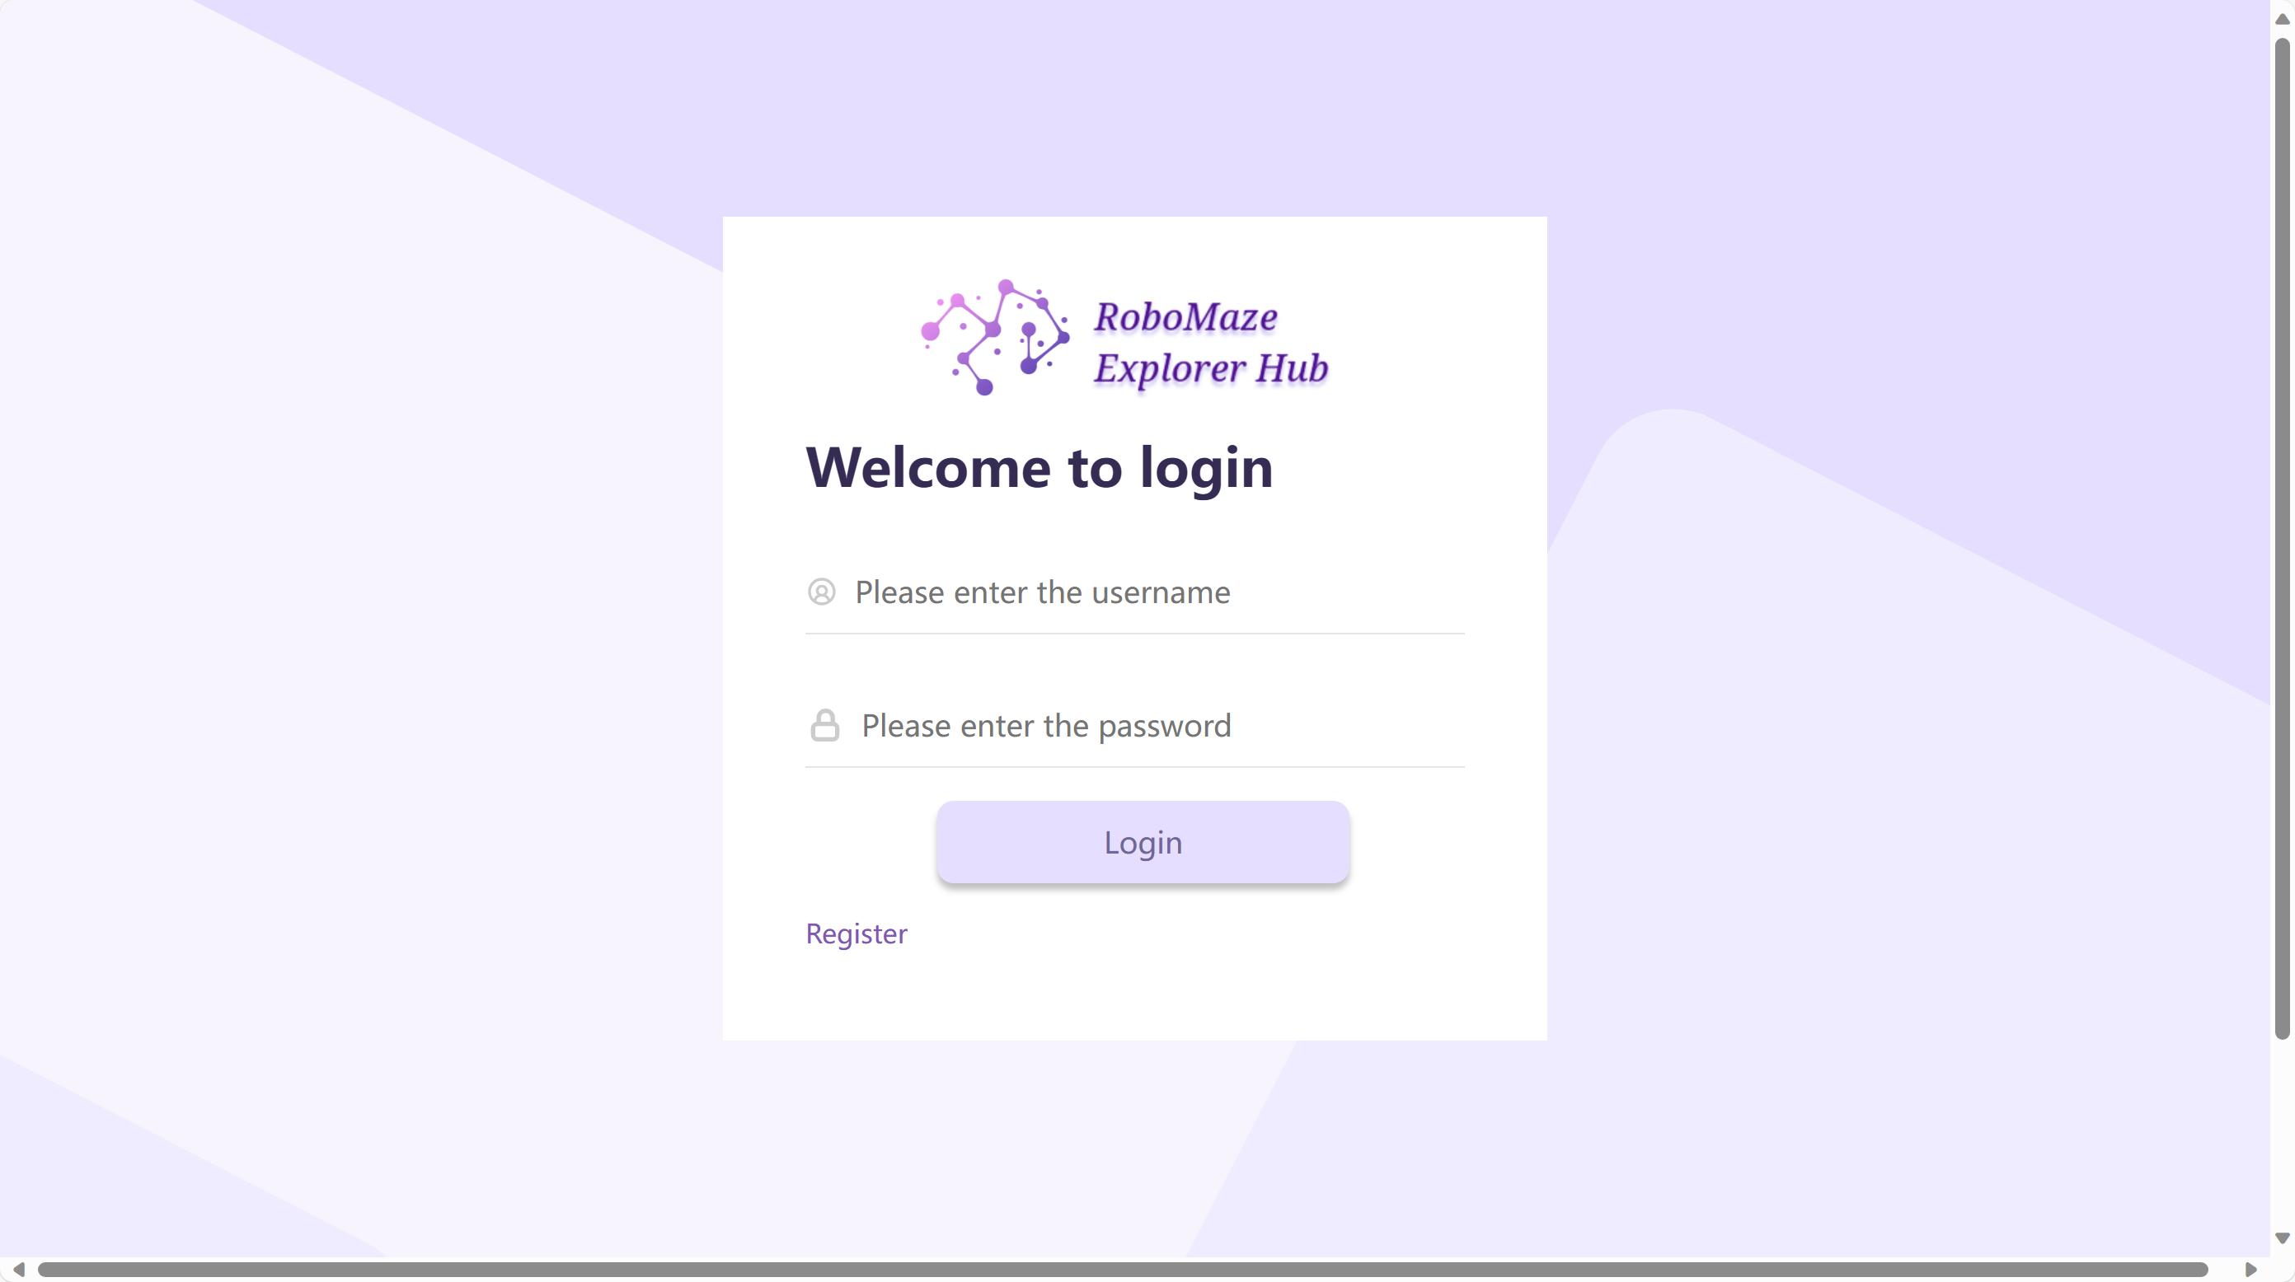
Login & logout
Prompts in every input box;
New prompts appear if invalid inputs are entered.

Slide 5
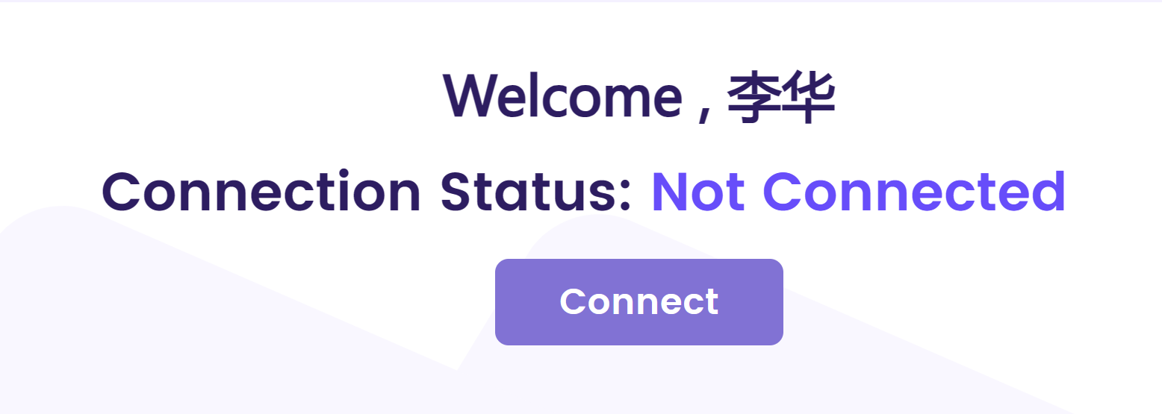
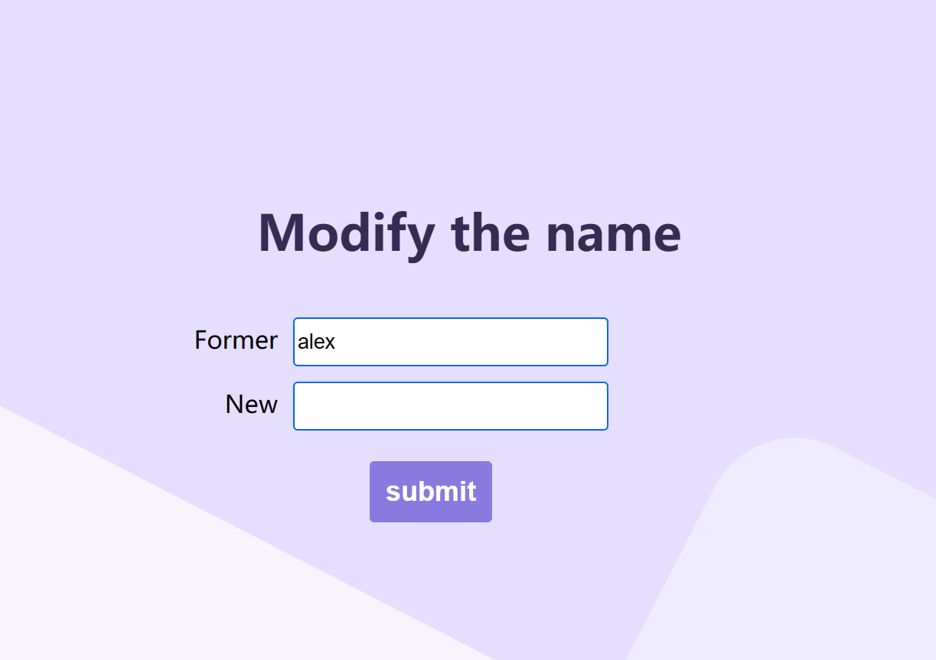
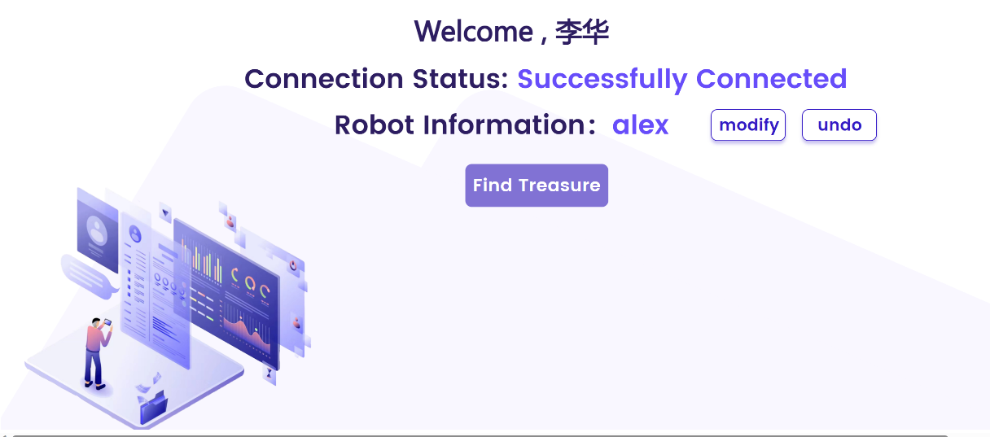
to connect the robot

Slide 6
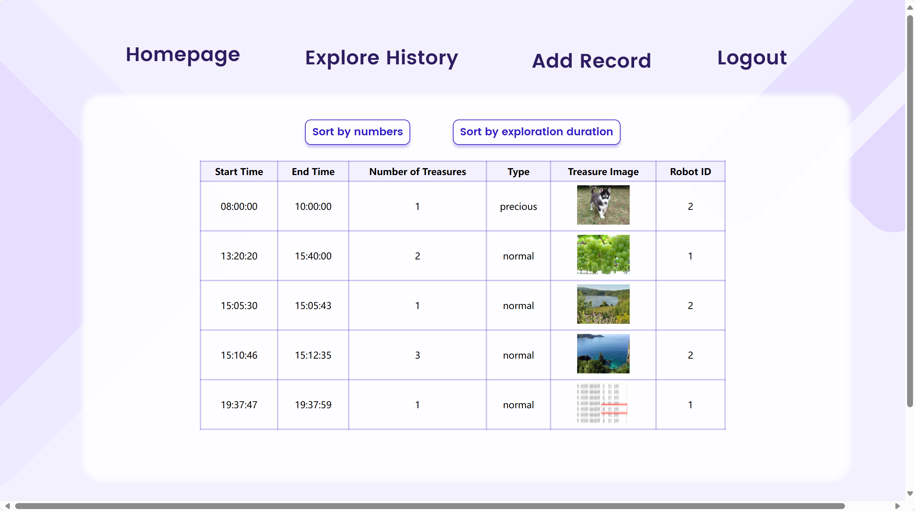
Exploration history
Sorting out by:
Number of Treasures
Time of Exploration

Slide 7
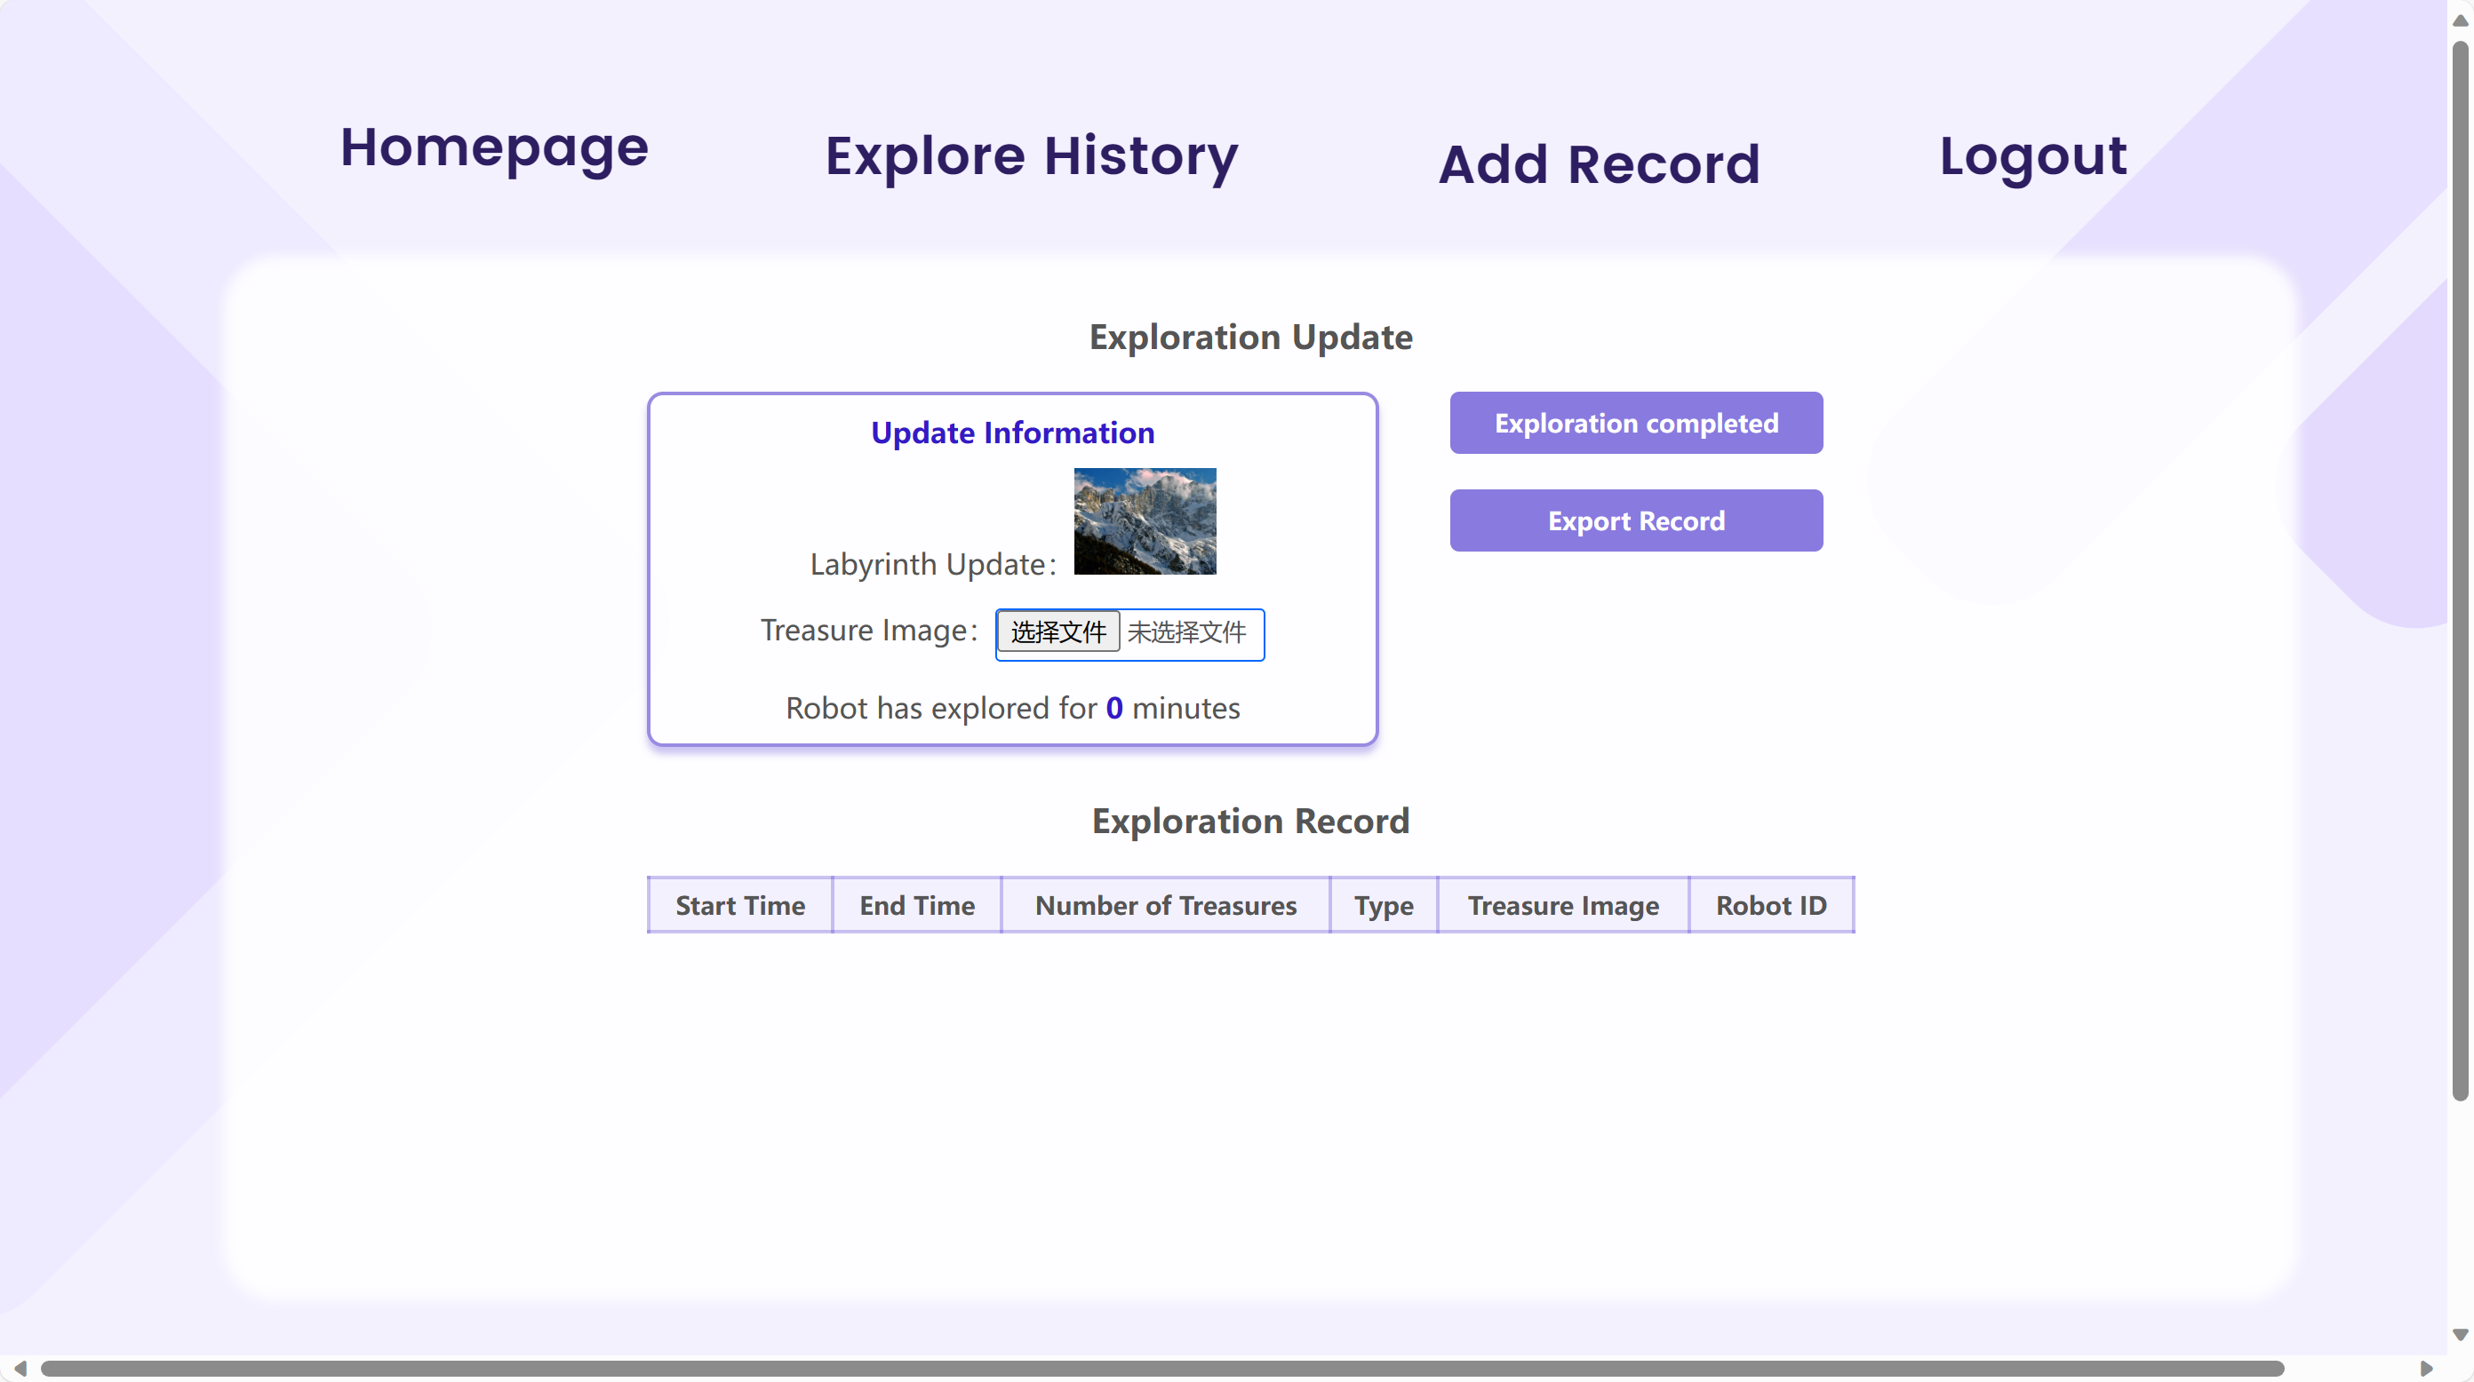
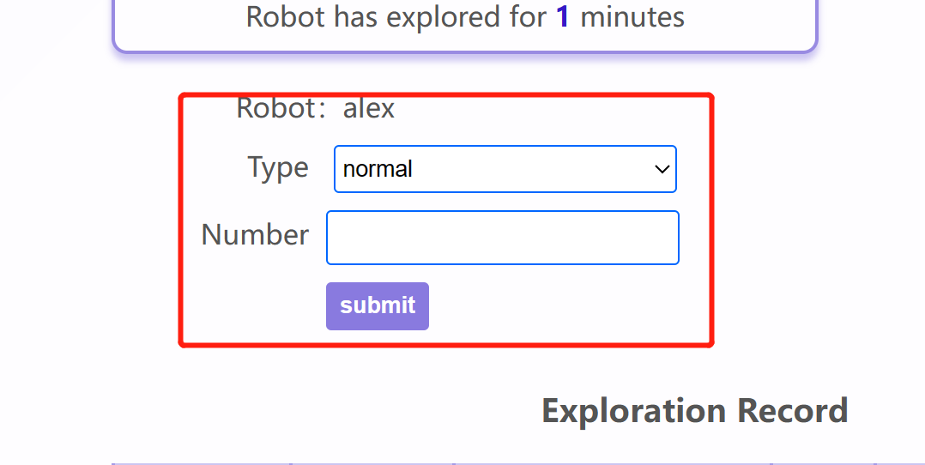
Exploration page
Displaying pictures of treasures and time of exploration;
Clicking on the “Exploration completed” to record the time;

Slide 8
2. About the Object Detection Software
Environment Setup
Downloading the YOLOv8 version and creating a virtual environment using Conda.
Data Collection and Annotation
Downloading over 2000 images online;
Using the labeling tool, LabelImg, to annotate each image.
Model Training
Using the prepared dataset to train the YOLOv8 model.
Results Storage
Saving the model's detection results in the form of text files (.txt).

Slide 9
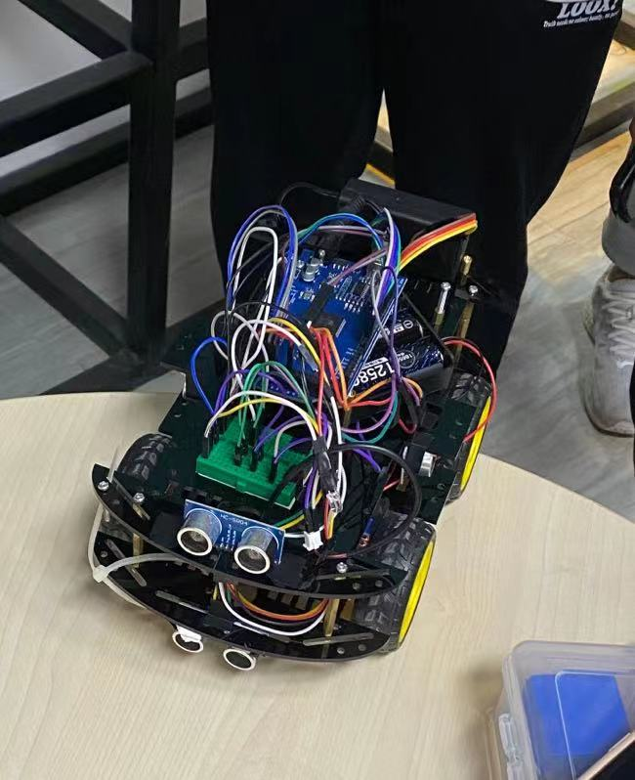
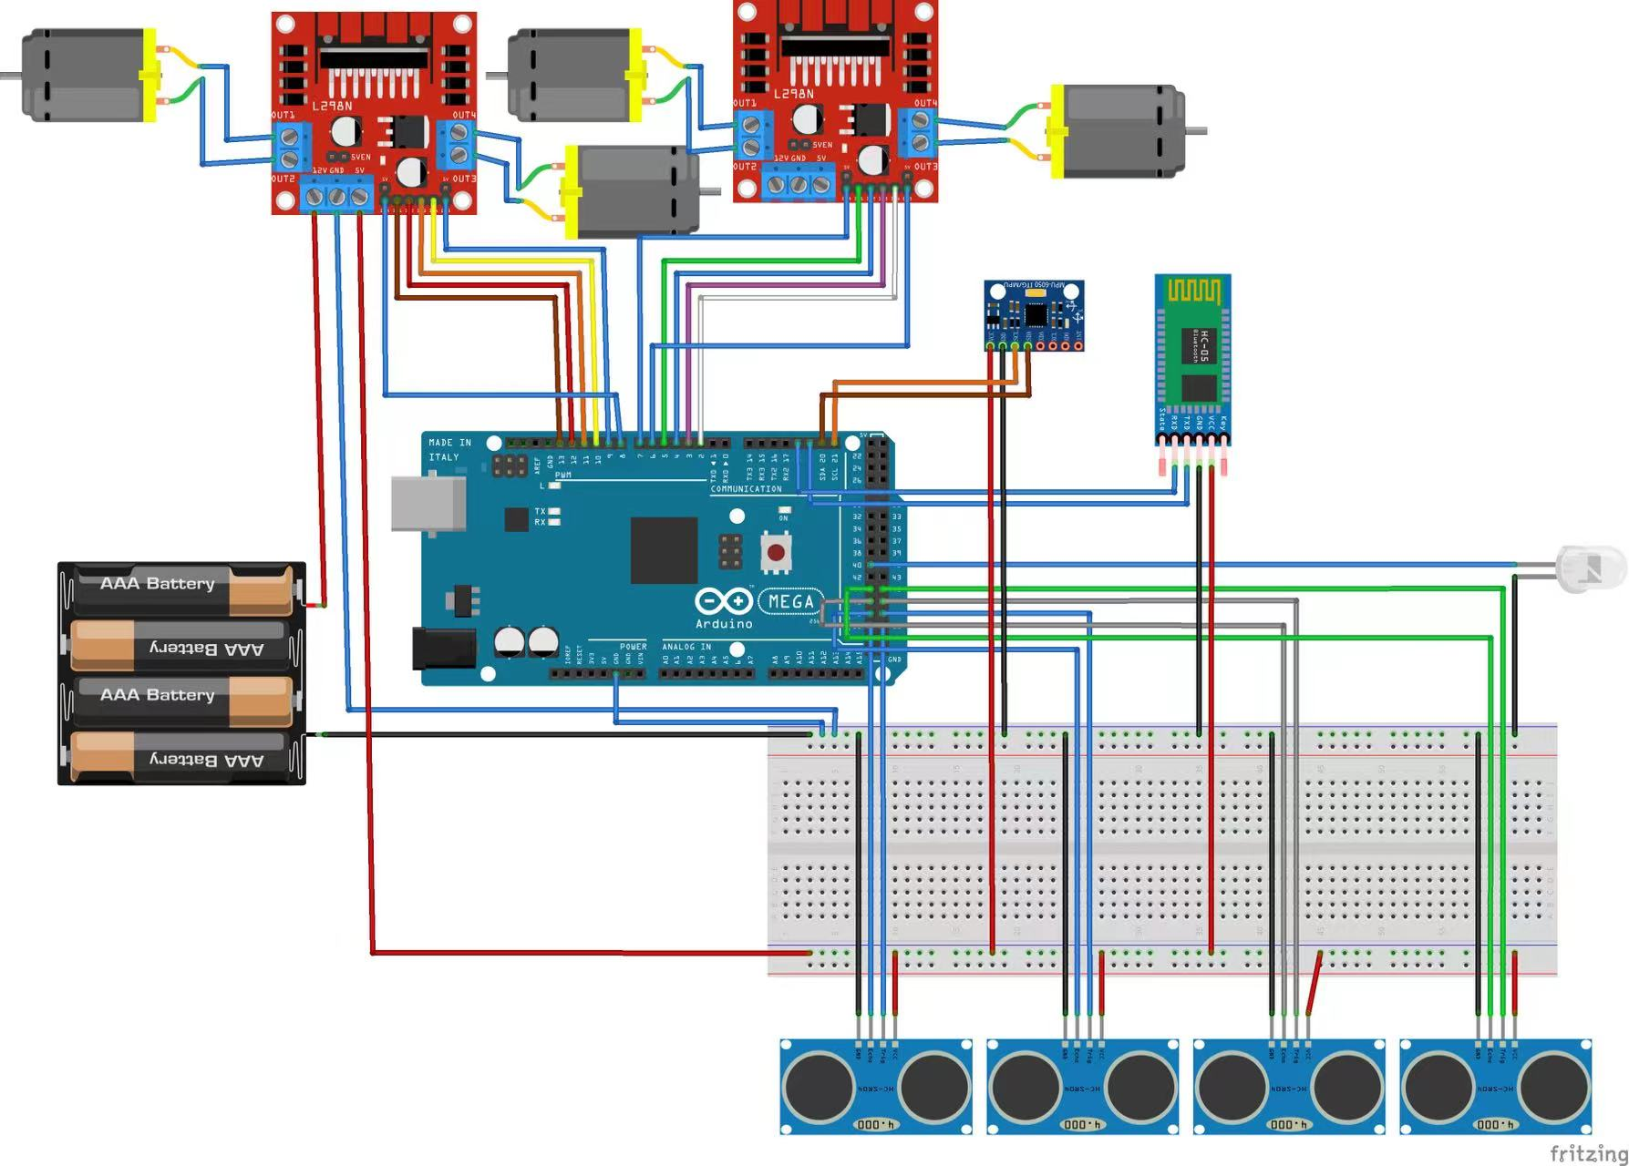
3. About the Robot

Slide 10
3. About the Robot
Exploring the maze;
Returning to the starting position;
Transmitting parameters via Bluetooth to the website;
Transmitting video via Wi-Fi to the object detection algorithm to recognize the treasure in real time;
Generating the route as a picture after exploration.

Slide 11
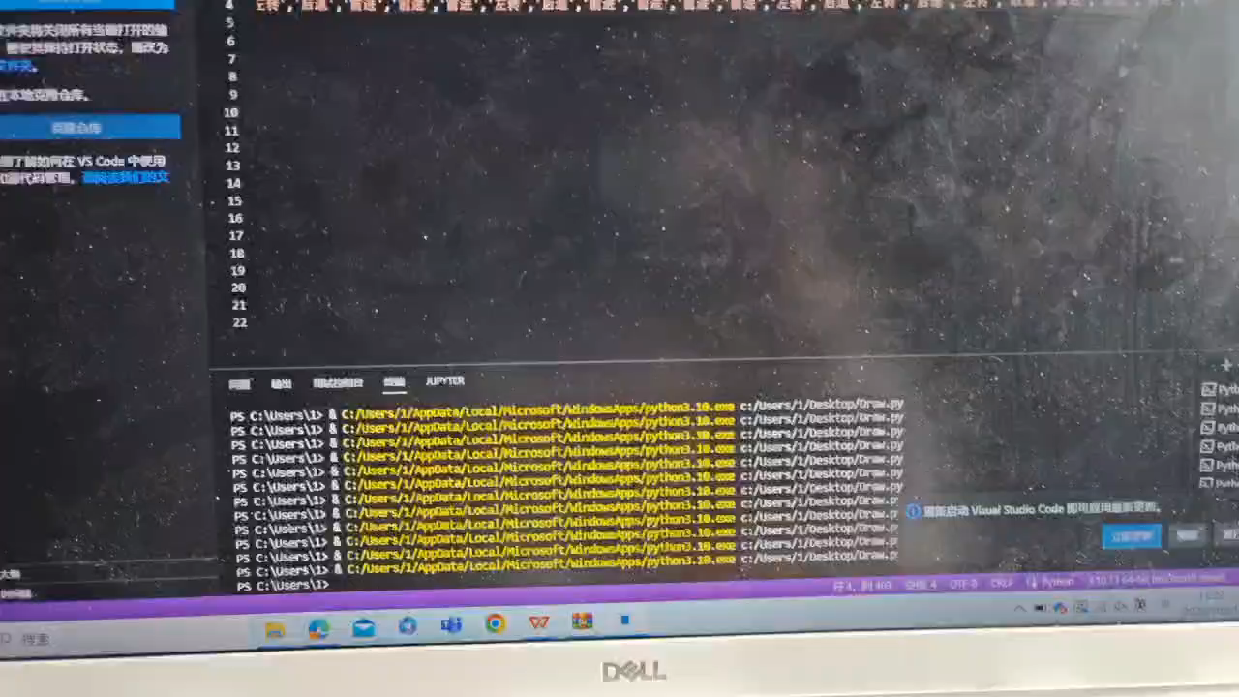
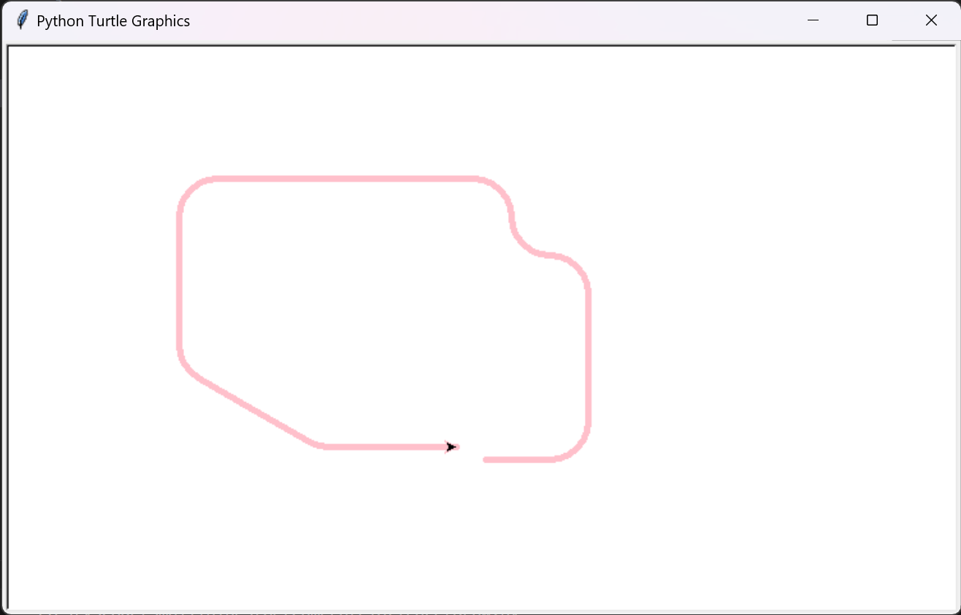
3. About the Robot

Slide 12
Thanks for Listening

